Slide 1
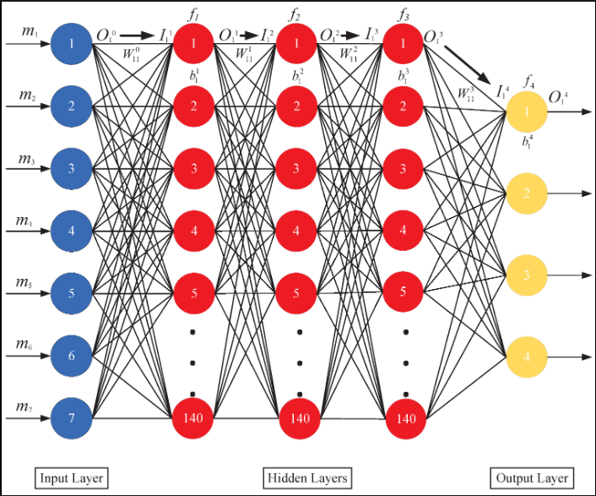
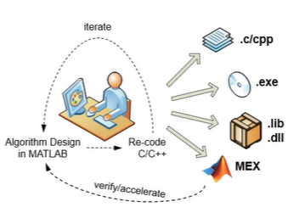
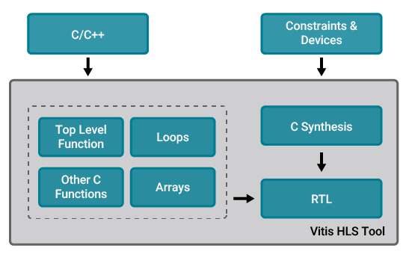
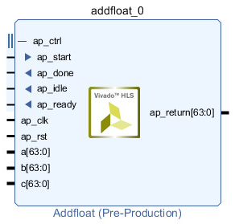
Step 1 : Generation of IP Block for DNN Model :
DNN Trained Model in MATLAB
Convert it from MATLAB to C/C++
Create a RTL IP on Vitis HLS from C++
VHDL/Verilog IP Block Generated
HDL Coder

Slide 2
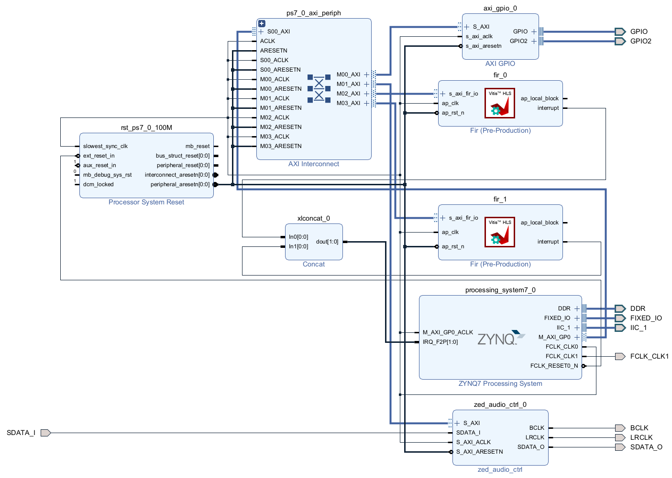
Step II : Integrating the DNN IP with Zynq PS and RF-DCs
Generate Bit-Stream file(.bit) for FPGA

Slide 3
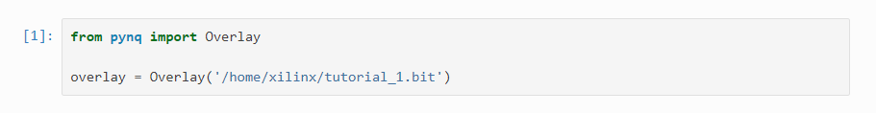
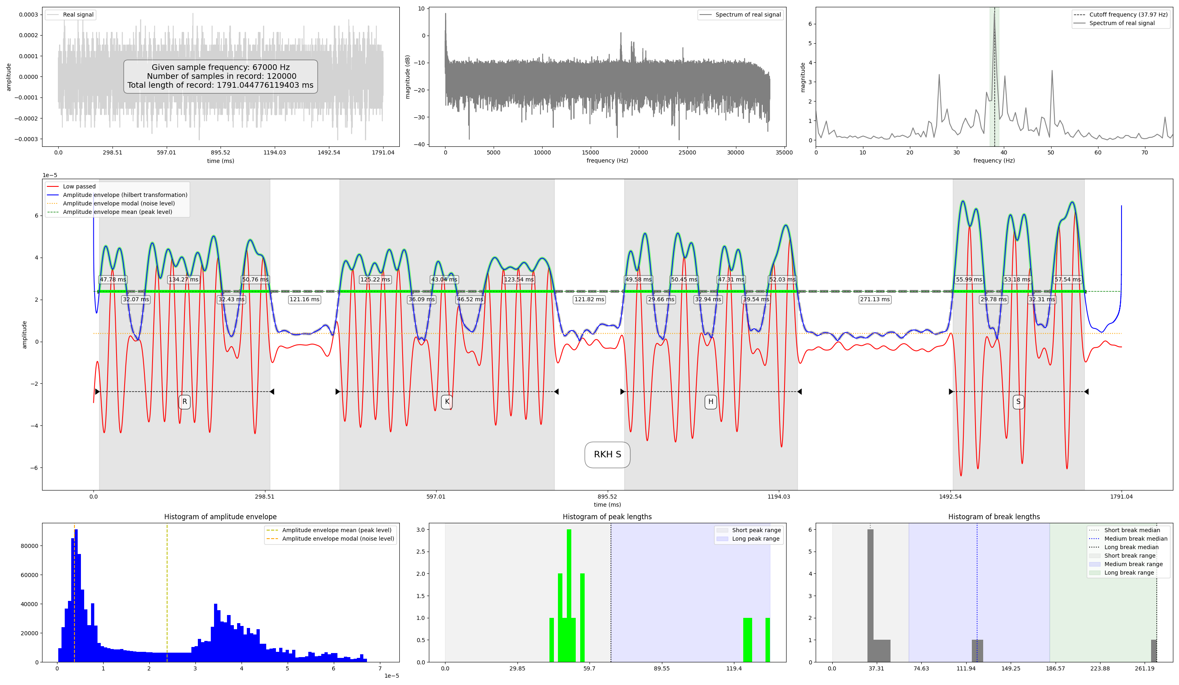
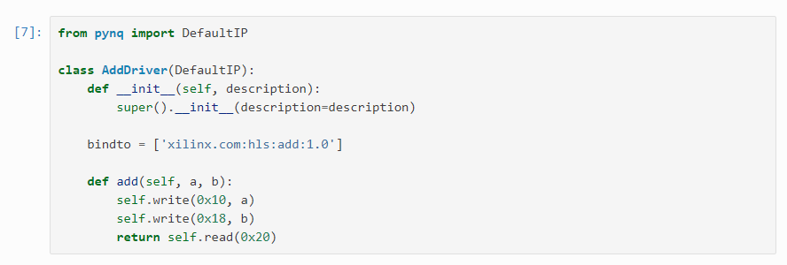
Step III : Create Custom Overlay on Jupyter with .bit file
Create custom overlay with bitstream which enables the Zynq PS to access data from RF-DCs and FPGA (PL).
Create the handler for different data items and functions of PL and RF data on Jupyter notebook to access and analyze using PYNQ.
Built GUI on jupyter notebook to investigate and analyze signal at different stages from DC’s to final identified signal.
GUI for Analysis
Overlay and Driver Creation

